Slide 1
Palindrome Usage in Mycobacteriophage Genomes
Julia Gross
Brandon Le

Slide 2
Why Palindromes?
Possible Biological Function: Restriction Sites
Clearly defined
Useful sampling population for gauging linguistic complexity more generally

Slide 3
DNA Palindromes
Same when read 5’ to 3’ and 3’ to 5’.
Not necessarily what you think of when you think palindrome:
5’ G A T C 3’
3’ C A T G 5’ → 5’ G A T C 3’
We focused on 4-mer and 6-mer palindromes.

Slide 4
How to characterize genomes?
Read in a phage genome, 4 bases at a time:
“CAGATCGGTATCCCCGACGCACACCCGGTCGTTT”

Slide 5
How to characterize genomes?
Read in a phage genome, 4 bases at a time:
“CAGATCGGTATCCCCGACGCACACCCGGTCGTTT”

Slide 6
How to characterize genomes?
Read in a phage genome, 4 bases at a time:
“CAGATCGGTATCCCCGACGCACACCCGGTCGTTT”
That one’s a palindrome!

Slide 7
How to characterize genomes?
Read in a phage genome, 4 bases at a time:
“CAGATCGGTATCCCCGACGCACACCCGGTCGTTT”

Slide 8
How to characterize genomes?
Read in a phage genome, 4 bases at a time:
“CAGATCGGTATCCCCGACGCACACCCGGTCGTTT”
Count up all the times you encounter tetra-nucleotide palindromes in the 60,000+ bp genome. This is the observed count.
Calculate how many times you expect to see each palindrome, given genome length and GC content. This is the expected count.

Slide 9
Comparing to Expectations
The “unexpectedness” of each palindrome count can be summed up nicely by dividing observed count / expected count.
We call this metric usage deviation.
UD value: 0-.1 = extremely underrepresented
UD value: .2-1.9 = more or less as expected
UD value: 2+ = over-represented
We analyzed 840 genomes * ≈60 kb / genome = over 50,000 kb
Notes:
Which is all nice and everything, but what did we find???
Well, that can be represented at multiple levels…

Slide 10
The Gigantic Picture– all 6-mers

Slide 12
The Big Picture – all 4-mers

Slide 13
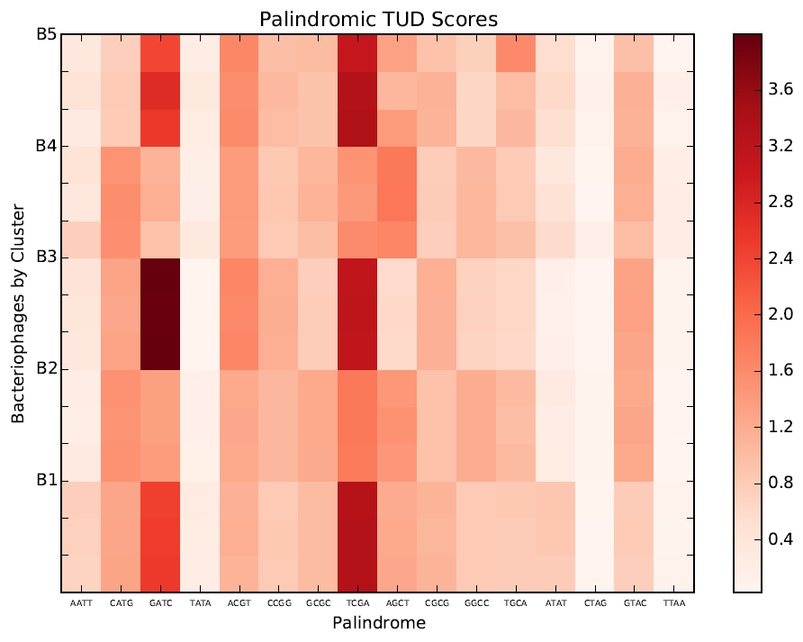
The Useful Summary – selected cluster B

Slide 14
Key Trends:
Consistent with other literature, these data demonstrate that in general, palindromes are under-represented.
Many genomes lack even a single example of certain 6-mer palindromes, most of which are AT-rich.
Examples of severe underrepresentation of ATAT and AATT occur in clusters A4 and A2 respectively.
There are also small, but dramatic pockets of extreme over-representation, such as GATC in cluster B3 phages.

Slide 15
Under Representation

Slide 16
Over Representation
To study over-representation, we focused on the case of GATC which is highly over-expressed in B3 phage genomes, but expressed at normal levels in the genomes of other cluster B phages.
We thus took all the gene products of a model B3 phage, ran an NCBI BLAST search on each one, gathered all the pairwise alignments of each B3 gp against all the non B3 cluster B gp hits that came up in the BLAST.

Slide 17
Pairwise Alignment Comparisons
B phage, gpX
gp1
B phage, gpY
B phage, gpZ
B phage, gpA
B3 Phage
gp2
B phage, gpY
= BLAST pairwise alignment with E < -.001
B phage, gpZ
B phage, gpA
gp3
B phage, gpY
B phage, gpB
B phage, gpC

Slide 18
Comparing Pairwise Alignments
B3: “
BX: “

Slide 19
Across all alignments, against all B3 gps…
What fraction GATC sites were the same in both phages?
What is the frequency of non-B3 phage gps containing GATC sites with no corresponding B3 GATC site?
Of the sites where the B3 phage had GATC, and the non-B3 phage did not, how “off” was the corresponding B3 site?
Of the sites that only mismatched by one base, which was the base that was most commonly mismatched?
What was the most common 1-off transversion?

Slide 20
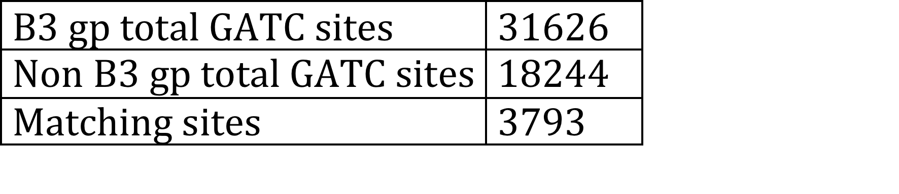
How Well do the GATCs Match?
Notes:
#s from find_totals_methods_and_main.py in pairwise_main_scripts
This implies that B3 has an entirely different distribution of GATC sites within the genome than non B3!

Slide 21
How Well do the GATCs Match?
Just 12% of the B3 gp GATC sites are accounted for by exact matching!
Notes:
#s from find_totals_methods_and_main.py in pairwise_main_scripts
This implies that B3 has an entirely different distribution of GATC sites within the genome than non B3!

Slide 22
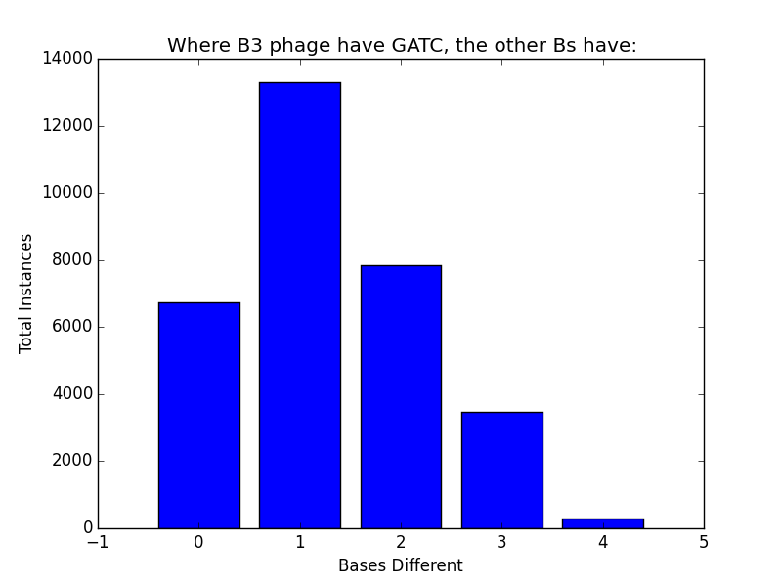
Notes:
#comes from find_degrees_off_graph_imports_main.py in pairwise_main_scripts

Slide 24
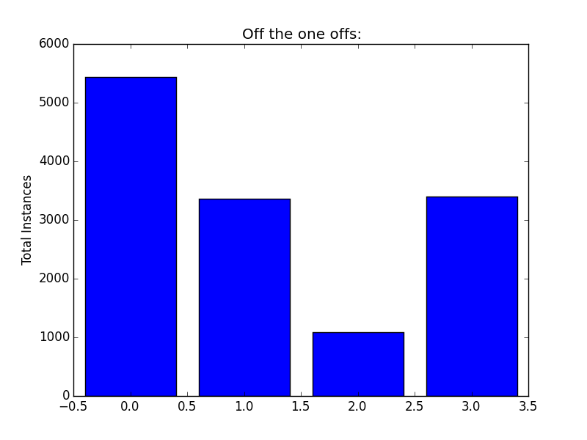
NATC GNTC GANC GATN
Notes:
#comes from find_one_offs_imports_method_main.py in pairwise_main_scripts

Slide 25
NATC GNTC GANC GATN

Slide 26
Off NATC, N =

Slide 27
Known Restriction Sites

Slide 28
Conclusions

